Slide 1

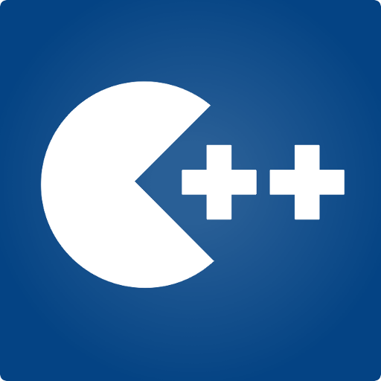
Programming Fundamentals
Taimur Sajjad
MS(Data Science)
MS(Mob. Computing)
Lecturer (Computer Science),,
CUI Wah Campus

Slide 2
What is an Identifier?
An identifier is the name to denote labels, types, variables, constants or functions, in a C++ program.
C++ is a case-sensitive language.
  Work is not work
Identifiers should be descriptive
  Using meaningful identifiers is a good programming practice

Slide 3
Identifier
Identifiers must be unique
Identifiers cannot be reserved words (keywords)
  double main return
Identifier must start with a letter or underscore, and be followed by zero or more letters (A-Z, a-z), digits (0-9), or underscores
VALID
age_of_dog _taxRateY2K
PrintHeading ageOfHorse
NOT VALID
age# 2000TaxRate Age-Of-Dog main

Slide 4
C++ Data Types
simple
structured
integral enum
floating
array struct union class
char short int long bool
address
float double long double
pointer reference

Slide 5
C++ Primitive Data Types
Primitive types
integral
floating
char short int long bool float double long double
unsigned

Slide 6
Premitive Data Types in C++
Integral Types
  represent whole numbers and their negatives
  declared as int, short, or long
Character Types
  represent single characters
  declared as char
  Stored by ASCII values
Boolean Type
    declared as bool
    has only 2 values true/false
    will not print out directly
Floating Types
  represent real numbers with a decimal point
  declared as float, or double
  Scientific notation where e (or E) stand for “times 10 to the ” (.55-e6)

Slide 7
Samples of C++ Data Values
int sample values
  4578 -4578 0
bool values
  true false
float sample values
  95.274 95.0 .265
char sample values
‘B’ ‘d’ ‘4’ ‘?’ ‘*’

Slide 8
What is a Variable?
A variable is a memory address where data can be stored and changed.
Declaring a variable means specifying both its name and its data type.

Slide 9
What Does a
Variable Declaration Do?
A declaration tells the compiler to allocate enough memory to hold a value of this data type, and to associate the identifier with this location.
int ageOfDog;→
char middleInitial; →
float taxRate;→

Slide 10
Variable Declaration
All variables must declared before use.
  At the top of the program
  Just before use.
Commas are used to separate identifiers of the same type.
  int count, age;
Variables can be initialized to a starting value when they are declared
  int count = 0;
  int age, count = 0;

Slide 11
What is an Expression in C++?
An expression is a valid arrangement of variables, constants, and operators.
In C++, each expression can be evaluated to compute a value of a given type
In C++, an expression can be:
  A variable or a constant (count, 100)
  An operation (a + b, a * 2)
  Function call (getRectangleArea(2, 4))

Slide 12
Assignment Operator
An operator to give (assign) a value to a variable.
Denote as ‘=‘
Only variable can be on the left side.
An expression is on the right side.
Variables keep their assigned values until changed by another assignment statement or by reading in a new value.

Slide 13
Assignment Operator Syntax
Variable = Expression
  First, expression on right is evaluated.
  Then the resulting value is stored in the memory location of Variable on left.
NOTE: An automatic type coercion occurs after evaluation but before the value is stored if the types differ for Expression and Variable

Slide 14
Assignment Operator Mechanism
Example:
  int count = 0;
  int starting;
  starting = count + 5;
Expression evaluation:
  Get value of count: 0
  Add 5 to it.
  Assign to starting
0
12345 (garbage)
5

Slide 15
Input and Output
C++ treats input and output as a stream of characters.
stream : sequence of characters (printable or nonprintable)
The functions to allow standard I/O are in iostream header file or iostream.h.
Thus, we start every program with
  #include <iostream>
  using namespace std;

Slide 16
Include Directives and Namespaces
include: directive copies that file into your program
namespace: a collection of names and their definitions. Allows different namespaces to use the same names without confusion

Slide 17
Keyboard and Screen I/O
#include <iostream>
input data
output data
executing
program
Keyboard
Screen
cin
(of type istream)
cout
(of type ostream)

Slide 18
Insertion Operator ( << )
Variable cout is predefined to denote an output stream that goes to the standard output device (display screen).
The insertion operator << called “put to” takes 2 operands.
The left operand is a stream expression, such as cout. The right operand is an expression of simple type or a string constant.

Slide 19
Output Statements
SYNTAX
cout statements can be linked together using << operator.
These examples yield the same output:
cout << “The answer is “ ;
cout << 3 * 4 ;
cout << “The answer is “ << 3 * 4 ;
cout << Expression << Expression . . . ;

Slide 20
Output Statements (String constant)
String constants (in double quotes) are to be printed as is, without the quotes.
  cout<<“Enter the number of candy bars ”;
  OUTPUT: Enter the number of candy bars
“Enter the number of candy bars ” is called a prompt.
All user inputs must be preceded by a prompt to tell the user what is expected.
You must insert spaces inside the quotes if you want them in the output.
Do not put a string in quotes on multiple lines.

Slide 21
Output Statements (Expression)
All expressions are computed and then outputted.
  cout << “The answer is ” << 3 * 4 ;
  OUTPUT: The answer is 12

Slide 22
Escape Sequences
The backslash is called the escape character.
It tells the compiler that the next character is “escaping” it’s typical definition and is using its secondary definition.
Examples:
  new line: \n
  horizontal tab: \t
  backslash: \\
  double quote \”

Slide 23
Newline
cout<<“\n” and cout<<endl both are used to insert a blank line.
Advances the cursor to the start of the next line rather than to the next space.
Always end the output of all programs with this statement.

Slide 24
Formatting for Decimal Point Numbers
Typed float, or double
Use the three format statements (magic formula) to format to fixed decimal notation.
  cout.setf(ios::fixed);
  cout.setf(ios::showpoint);
  cout.precision(2);
setf “set flag” means that all real output will be formatted according to the function, until changed by either unsetting the flag or a new setf command.
ios:: means the functions from the iostream library

Slide 25
Extraction Operator (>>)
Variable cin is predefined to denote an input stream from the standard input device (the keyboard)
The extraction operator >> called “get from” takes 2 operands. The left operand is a stream expression, such as cin--the right operand is a variable of simple type.
Operator >> attempts to extract the next item from the input stream and store its value in the right operand variable.

Slide 26
Input Statements
SYNTAX
cin statements can be linked together using >> operator.
These examples yield the same output:
cin >> x;
cin >> y;
cin >> x >> y;
cin >> Variable >> Variable . . . ;

Slide 27
How Extraction Operator works?
Input is not entered until user presses <ENTER> key.
Allows backspacing to correct.
Skips whitespaces (space, tabs, etc.)
Multiple inputs are stored in the order entered:
    cin>>num1>>num2;
    User inputs: 3 4
    Assigns num1 = 3 and num2 = 4

Slide 28
Numeric Input
Leading blanks for numbers are ignored.
If the type is double, it will convert integer to double.
Keeps reading until blank or <ENTER>.
Remember to prompt for inputs

Slide 29
C++ Data Type String
A string is a sequence of characters enclosed in double quotes
string sample values
“Hello” “Year 2000” “1234”
The empty string (null string) contains no displayed characters and is written as “”

Slide 30
C++ Data Type String (cont.)
string is not a built-in (standard) type
  it is a programmer-defined data type
  it is provided in the C++ standard library
Need to include the following two lines:
  #include <string>
  using namespace std;
string operations include
  comparing 2 string values
  searching a string for a particular character
  joining one string to another (concatenation)
  etc...

Slide 31
Type compatibilities
Warning: If you store values of one type in variable of another type the results can be inconsistent:
  Can store integers in floating point or in char (assumes ASCII value)
  bool can be stored as int: (true = nonzero, false = 0)
Implicit promotion: integers are promoted to doubles
  double var = 2; // results in var = 2.0
On integer and doubles together:
  Mixed type expressions: Both must be int to return int, otherwise float.

Slide 32
Type compatibilities (Implicit Conversion)
The compiler tries to be value-preserving.
General rule: promote up to the first type that can contain the value of the expression.
Note that representation doesn’t change but values can be altered .
Promotes to the smallest type that can hold both values.
If assign float to int will truncate
    int_variable = 2.99; // results in 2 being stored in int_variable
If assign int to float will promote to double:
  double dvar = 2; // results in 2.0 being stored in dvar

Slide 33
Type compatibilities (Explicit Conversion)
Casting - forcing conversion by putting (type) in front of variable or expression. Used to insure that result is of desired type.
Example: If you want to divide two integers and get a real result you must cast one to double so that a real divide occurs and store the result in a double.
    int x=5, y=2; double z; z = static_cast <double>(x)/y; // 2.5
    int x=5, y=2; double z; z = (double)x/y; // 2.5
    int x=5, y=2; double z; z = static_cast <double>(x/y) ; // 2.0
converts x to double and then does mixed division, not integer divide
static_cast<int> (z) - will truncate z
static_cast <int> (x + 0.5) - will round positive x {use () to cast complete expression)
Cast division of integers to give real result:
    int x=5, y=2; double z; z = static_cast <double>(x/y) ; // 2.0

Slide 34
Arithmetic Operators
Operators: +, -, * /
For floating numbers, the result as same as Math operations.
Note on integer division: the result is an integer. 7/2 is 3.
% (remainder or modulo) is the special operator just for integer. It yields an integer as the result. 7%2 is 1.
Both / and % can only be used for positive integers.
Precedence rule is similar to Math.

Slide 35
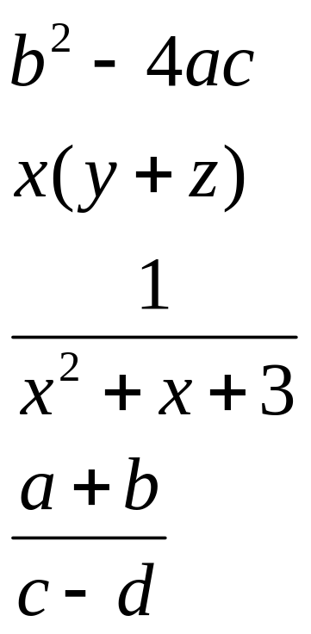
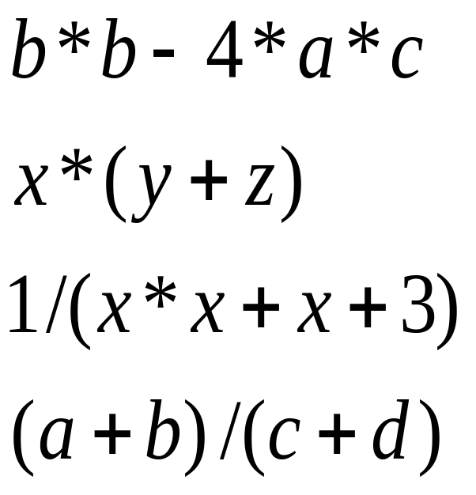
Arithmetic Expressions
Arithmetic operations can be used to express the mathematic expression in C++:

Slide 36
Simple Flow of Control
Three processes a computer can do:
  Sequential
    expressions, insertion and extraction operations
  Selection (Branching)
    if statement, switch statement
  Repetition/Iteration (Loop)
    while loop, do-while loop, for loop

Slide 37
bool Data Type
Type bool is a built-in type consisting of just 2 values, the constants true and false
We can declare variables of type bool
  bool hasFever; // true if has high temperature
  bool isSenior; // true if age is at least 55
The value 0 represents false
ANY non-zero value represents true

Slide 38
Boolean Expression
Expression that yields bool result
Include:
  6 Relational Operators
  < <= > >= == !=
  3 Logical Operators
  ! && ||

Slide 39
Relational Operators
are used in boolean expressions of form:
ExpressionA Operator ExpressionB
  temperature > humidity
  B * B - 4.0 * A * C > 0.0
  abs (number) == 35
  initial != ‘Q’
Notes:
  == (equivalency) is NOT = (assignment)
  characters are compared alphabetically. However, lowercase letters are higher ASCII value.
  An integer variable can be assigned the result of a logical expression
  You cannot string inequalities together:
      Bad Code: 4<x<6 Good Code: (x > 4) &&(x < 6)

Slide 40
Relational Operators
int x, y ;
x = 4;
y = 6;
EXPRESSION VALUE
x < y true
x + 2 < y false
x != y true
x + 3 >= y true
y == x false
y == x+2 true
y = x + 3 7
y = x < 3 0
y = x > 3 1

Slide 41
Logical Operators
are used in boolean expressions of form:
ExpressionA Operator ExpressionB
A || B (true if either A or B or both are true. It is false otherwise)
A && B (true if both A and B are true. It is false otherwise)
or
Operator Expression
!A (true if A is false. It is false if A is true)
Notes:
Highest precedence for NOT, AND and OR are low precedence.
Associate left to right with low precedence. Use parenthesis to override priority or for clarification
  x && y || z will evaluate “x && y ” first
  x && (y || z) will evaluate “y || z” first

Slide 42
Logical Operators
int age ;
bool isSenior, hasFever ;
float temperature ;
age = 20;
temperature = 102.0 ;
isSenior = (age >= 55) ; // isSenior is false
hasFever = (temperature > 98.6) ; // hasFever is true
EXPRESSION VALUE
isSenior && hasFever false
isSenior || hasFever true
!isSenior true
!hasFever false

Slide 43
Precedence Chart
++, --, !, - (unary minus), + (unary plus)
*, /, %
+ (addition), - (subtraction)
<<, >>
<, <=, >, >=
==, !=
&&
||
=
Highest
Lowest

Slide 44
Boolean Expression (examples)
taxRate is over 25% and income is less than $20000
temperature is less than or equal to 75 or humidity is less than 70%
age is between 21 and 60
age is 21 or 22

Slide 45
Boolean Expression (examples)
(taxRate > .25) && (income < 20000)
(temperature <= 75) || (humidity < .70)
(age >= 21) && (age <= 60)
(age == 21) || (age == 22)

Slide 46
General rules for Comments
Place a comment at the beginning of every file with the file name, version number, a brief program description, programmer’s name.
Place a descriptive comment after each variable declared.
  Use a blank line before and after variable declarations
Place a descriptive comment and a blank line before each subtask.

Slide 47
Constants
Syntax: const type identifier = value;
Ex: const double TAX_RATE = 0.08;
Convention: use upper case for constant ID.

